Slide 1
Unit 5

Slide 2
Collection Framework
A collection — sometimes called a container is simply an object that groups multiple elements into a single unit.
Collection framework provides a well designed set of Interfaces and classes for storing and manipulating groups of data as a single unit, a Collection.
Collections in Java are part of the Java Collections Framework, which is a set of classes and interfaces in the java.util package that provide data structures to store, manipulate, and manage groups of objects.

Slide 3
Common interfaces in the Java Collections Framework include:
Collection: The root interface for collections, which defines the basic operations common to all collection types.
List: Represents an ordered collection with duplicate elements. Implementations include ArrayList, LinkedList, and Vector.
Set: Represents an unordered collection of unique elements (duplicate elements NOT allowed). Implementations include HashSet, LinkedHashSet, and TreeSet.
Map: Represents a collection of key-value pairs. Implementations include HashMap, LinkedHashMap, and TreeMap.
Queue: Represents a collection that orders its elements based on a specific ordering rule. Implementations include PriorityQueue.
Deque: Represents a double-ended queue, allowing elements to be added or removed from both ends. Implementations include ArrayDeque and LinkedList.

Slide 4
SET INTERFACE
The Set interface having no new methods beyond those inherited from its parent interface, Collection.
It primarily focuses on ensuring uniqueness of elements.
The Set interface is implemented by several classes, including HashSet, LinkedHashSet, and TreeSet.
Set do not allow duplicate entries.
Here are the core methods defined in the Set interface:

Slide 5
add(E e): Adds an element to the set if it is not already present.
contains(Object o): Checks if the set contains a specific element. Returns true if the element is present, false otherwise.
isEmpty(): Returns true if the set contains no elements, false otherwise.
remove(Object o): Removes a specific element from the set, if it is present.
size(): Returns the number of elements in the set.

Slide 6
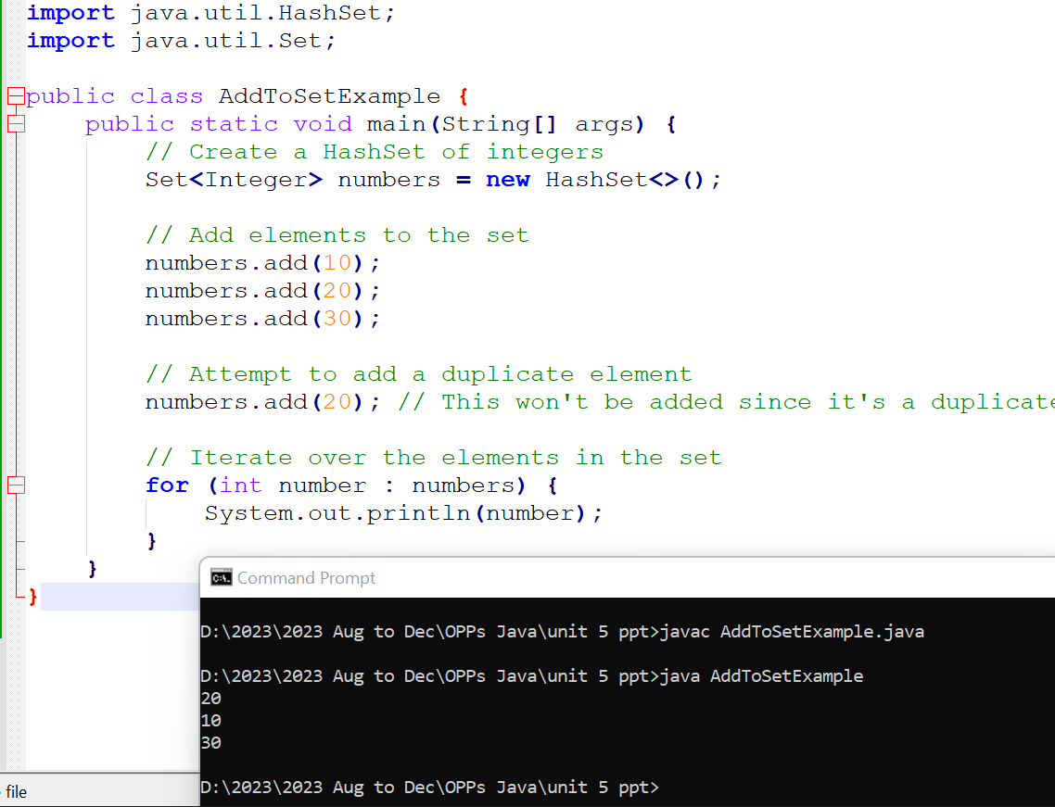
Example 1

Slide 7
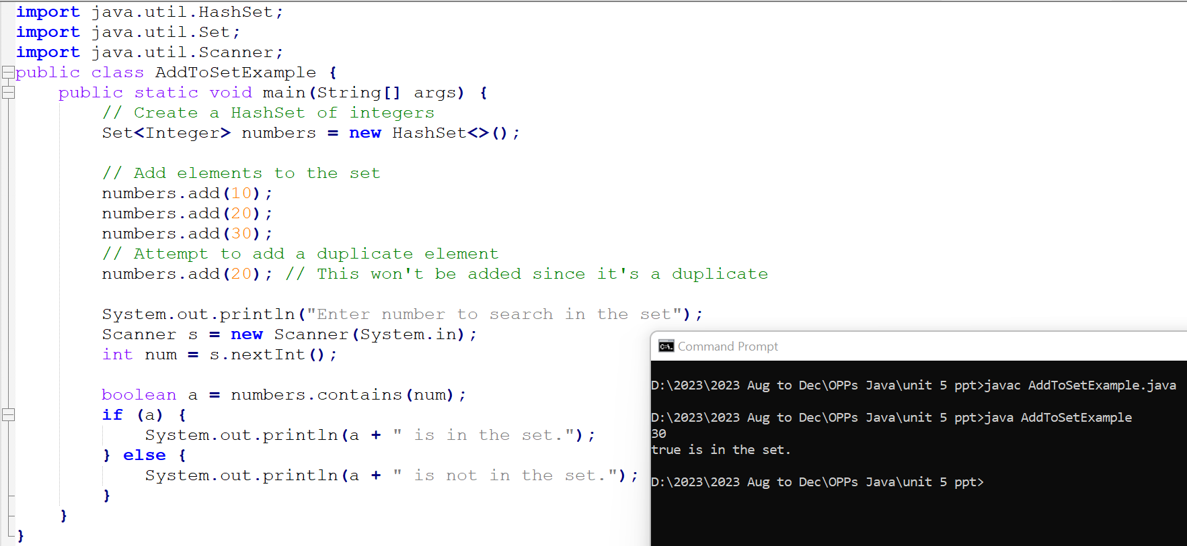
Example 2

Slide 8
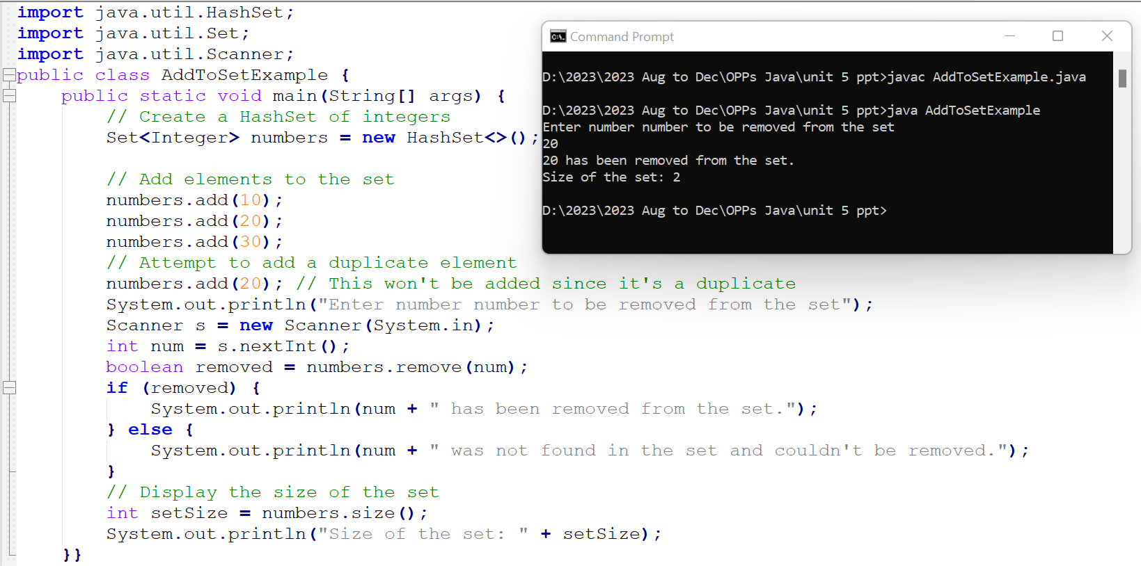
Example 3

Slide 9
List Interface
List interface is a part of the Collections framework and represents an ordered collection of elements that allows duplicate entries.
It maintains the insertion order, allowing positional access to elements.
Common implementations are ArrayList, LinkedList, and Vector.

Slide 10
Here are some key methods provided by the List interface:
Adding Elements:
boolean add(E e): Appends the specified element to the end of the list.
void add(int index, E element): Inserts the specified element at the specified position in the list.
Accessing Elements:
E get(int index): Returns the element at the specified position in the list.
int indexOf(Object o): Returns the index of the first occurrence of the specified element in the list, or -1 if not found.
Removing Elements:
E remove(int index): Removes the element at the specified position in the list and returns it.
boolean remove(Object o): Removes the first occurrence of the specified element from the list, if it exists.
Other Operations:
int size(): Returns the number of elements in the list.
void clear(): Removes all elements from the list.
boolean isEmpty(): Returns true if the list is empty; otherwise, returns false.
Where ‘E’ is a placeholder for any type.

Slide 11
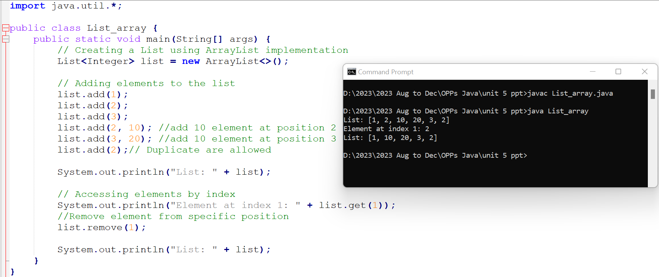

Slide 12
Introduction to JDBC
JDBC (Java Database Connectivity) is a Java API that allows Java programs to interact with databases.
It provides a standard interface for accessing relational databases, enabling developers to perform various database operations like connecting to databases, executing SQL queries, retrieving and modifying data, and handling transactions.

Slide 13
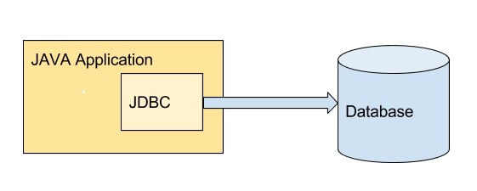
Introduction to JDBC

Slide 14
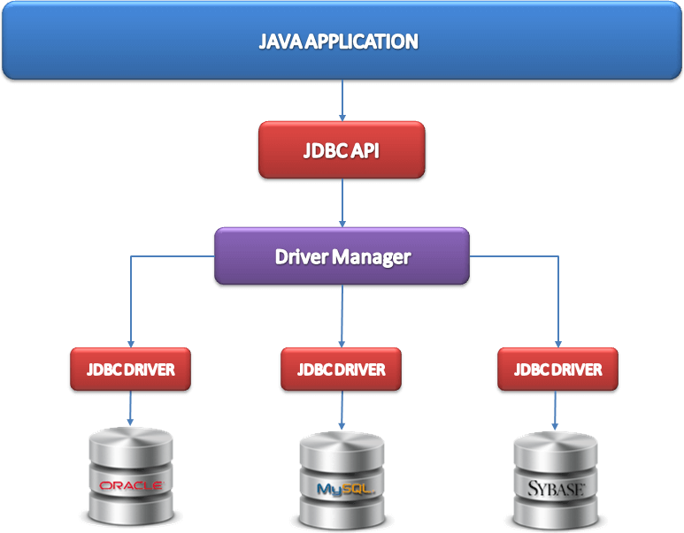
Introduction to JDBC

Slide 15
Key components of JDBC
1. DriverManager: Facilitates the establishment of a connection to a database by loading appropriate JDBC drivers.
2. JDBC Drivers: These are sets of classes implementing the JDBC interfaces, allowing Java applications to communicate with specific databases. Drivers can be categorized as:
Type 1: JDBC-ODBC bridge drivers (now deprecated) - Utilizes the ODBC (Open Database Connectivity) API to connect to the database. The JDBC calls are translated into ODBC calls, and then the ODBC driver interacts with the database.
Type 2: Native API partially Java driver - Uses a database-specific native client library to communicate with the database server. The JDBC driver communicates with this library, and the library interacts with the database.
Type 3: Network protocol pure Java driver - Acts as a middleware layer between the Java application and the database server. It translates JDBC calls into a middleware-specific network protocol, which is then translated into the database-specific protocol by the server.
Type 4: Native protocol pure Java driver (most commonly used) - Communicates directly with the database server using the database-specific protocol. It's entirely implemented in Java and doesn't require any additional software installation.
Notes:
"JDBC calls are translated into ODBC calls" essentially describes the process of converting the JDBC-specific method calls made by a Java application into commands understood by the ODBC (Open Database Connectivity) API, which in turn communicates with the database server.
A "native client library" refers to a set of precompiled functions or code libraries that are specific to a particular platform or system. These libraries contain code written in the native programming language of the platform, often in languages like C, C++, or assembly language.
A "middleware-specific network protocol" refers to a communication protocol designed for a specific middleware or intermediary software that facilitates communication between different applications, systems, or components within a distributed computing environment.

Slide 16
Key components of JDBC
3. Connection: Represents a connection to a specific database, allowing the execution of SQL queries and database operations.
4. Statement: Allows the execution of SQL queries and enables interaction with the database.
5. ResultSet: Represents the result of a database query. It allows the retrieval and manipulation of the query results.

Slide 17
Step of Establishing a JDBC Connection
Step 1: Import Necessary Packages:
Import the required JDBC packages in your Java program. Commonly used packages include:
import java.sql.Connection;
import java.sql.DriverManager;
import java.sql.SQLException;
import java.sql.Statement;
import java.sql.ResultSet;
Step 2: Load the Database Driver:
Load the specific database driver using Class.forName(). For instance, for MySQL:
try {
Class.forName("com.mysql.jdbc.Driver");
} catch (ClassNotFoundException e) {
e.printStackTrace();
}
However, the JDBC driver is being loaded implicitly by the DriverManager class in the DriverManager.getConnection(url, username, password) method call.

Slide 18
Step 3: Establish Connection:
Use DriverManager.getConnection() to create a connection to the database by providing the database URL, username, and password.
String jdbcURL = "jdbc:mysql://localhost:3306/your_database_name";
String username = "your_username";
String password = "your_password";
try {
Connection connection = DriverManager.getConnection(jdbcURL, username, password);
} catch (SQLException e) {
e.printStackTrace();
}
}

Slide 19
Step 4: Create SQL Statements:
After establishing the connection, create SQL statements (Statement, PreparedStatement, CallableStatement) to interact with the database.
try {
Statement statement = connection.createStatement();
// Execute SQL queries or updates
ResultSet resultSet = statement.executeQuery("SELECT * FROM your_table");
// Process the result set
while (resultSet.next()) {
// Access data from the result set
}
} catch (SQLException e) {
e.printStackTrace();
Step 5: Process Results (if any):
If executing queries, process the results obtained from the database using ResultSet methods like next(), getString(), getInt(), etc.

Slide 20
Step 6: Close Resources:
Properly close the resources (Connection, Statement, ResultSet) in a finally block or use try-with-resources to ensure resource release and avoid leaks.
try {
// Close the resources in reverse order of creation
if (resultSet != null) {
resultSet.close();
}
if (statement != null) {
statement.close();
}
if (connection != null) {
connection.close();
}
} catch (SQLException e) {
e.printStackTrace();
}

